Slide 1

Wavelet transform I
Kaifeng Zheng

Slide 2

outline
Fourier transform
Overview
Examples
Wavelet transform
Overview
Wavelets
Applications

Slide 3
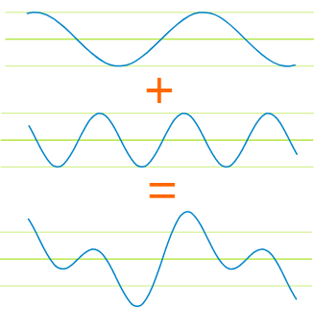

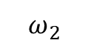
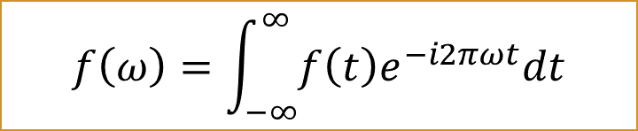
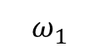
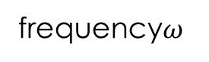
Decompose a wave
$$ω_{1}$$
frequency$ω$
low
$$f\left(ω\right)=\int_{−∞}^{∞}{f\left(t\right)e^{−i2πωt}dt}$$
$$ω_{2}$$
high
Basis functions are cosine and sine
$$f\left(t\right)=A_{1}\cos\left(ω_{1}t\right)+A_{2}\cos\left(ω_{2}t\right)+…$$
Give a wave, how to decompose it with the linear combination of several of Sine and cosine waves

Slide 4
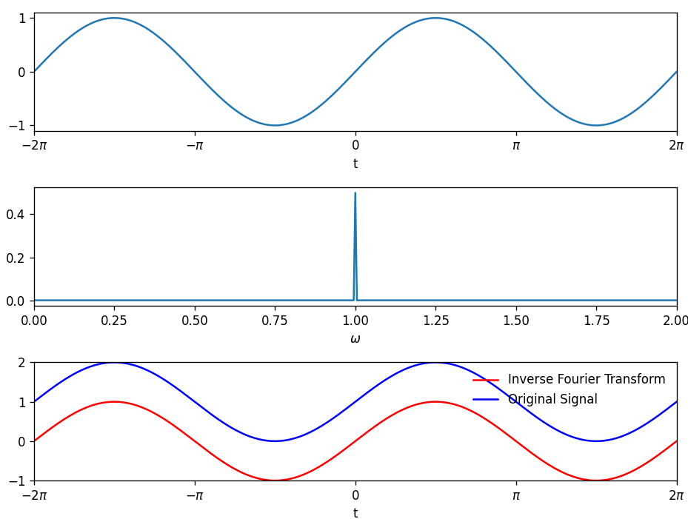
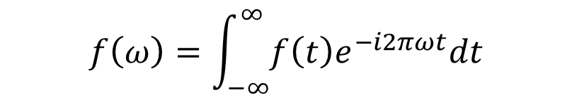
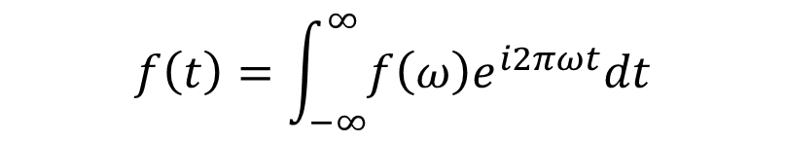
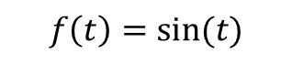
Fourier transform: two example(I)
$$f\left(t\right)=sin⁡(t)$$
Fourier transform:
$$f\left(ω\right)=\int_{−∞}^{∞}{f\left(t\right)e^{−i2πωt}dt}$$
Back Fourier transform
$$f\left(t\right)=\int_{−∞}^{∞}{f\left(ω\right)e^{i2πωt}dt}$$

Slide 5
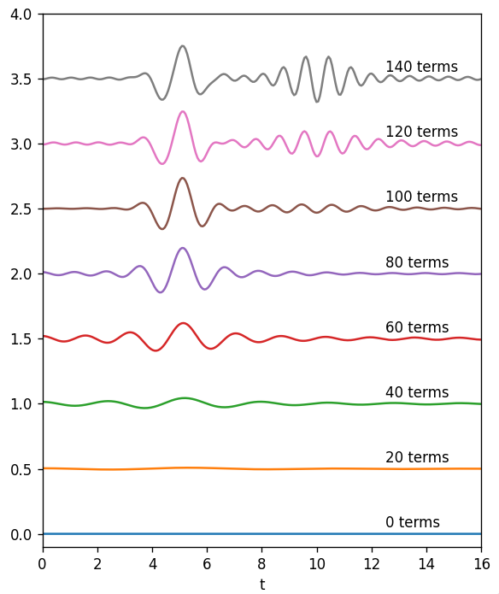
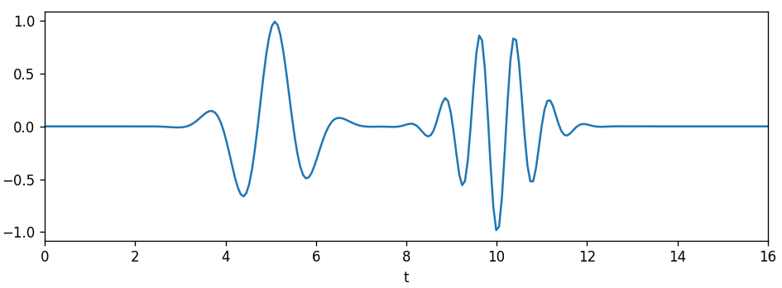
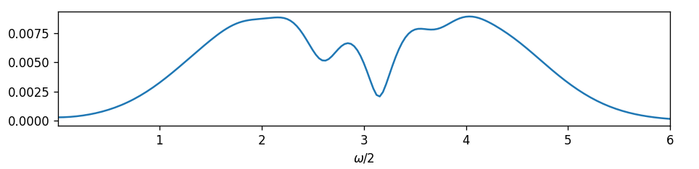



Fourier transform: two example(II)
$$f\left(ω\right)=\int_{−∞}^{∞}{f\left(x\right)e^{−i2πωx}dx}$$
reconstruct by using a set of cosine function:
$$f\left(x\right)=A_{1}\cos\left(ω_{1}x\right)+A_{2}\cos\left(ω_{2}x\right)+…$$
$$χ\left(t\right)=\sin\left(4t\right)e^{−{\left(t−5\right)}^{2}}\sin\left(8t\right)e^{−{\left(t−10\right)}^{2}}$$
Reconstruct
There is no information in t space
Janis Timoshenko et al. Computer Physics Communications 180 (2009) 920–925

Slide 6
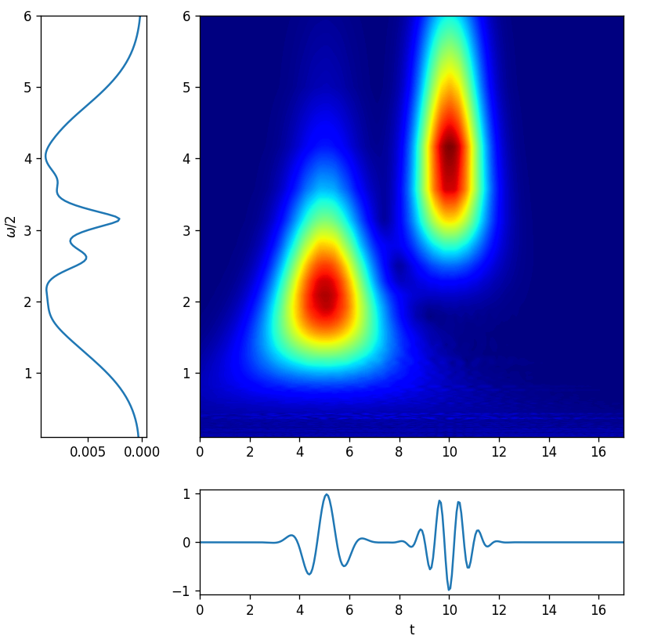

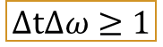
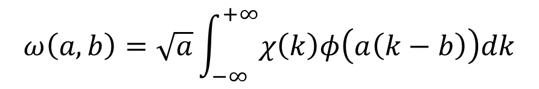
Multiresolution analysis --Wavelet transform(CWT)
$$ω\left(a,b\right)=\sqrt{a}\int_{−∞}^{+∞}{χ\left(k\right)φ\left(a\left(k−b\right)\right)dk}$$
$$χ\left(t\right)=\sin\left(4t\right)e^{−{\left(t−5\right)}^{2}}\sin\left(8t\right)e^{−{\left(t−10\right)}^{2}}$$
https://commons.wikimedia.org/wiki/File:Continuous_wavelet_transform.gif
Scaling(a)
Translation(b)
It can have resolution in t and frequency space
Tradeoff
$$ΔtΔω≥1$$

Slide 7
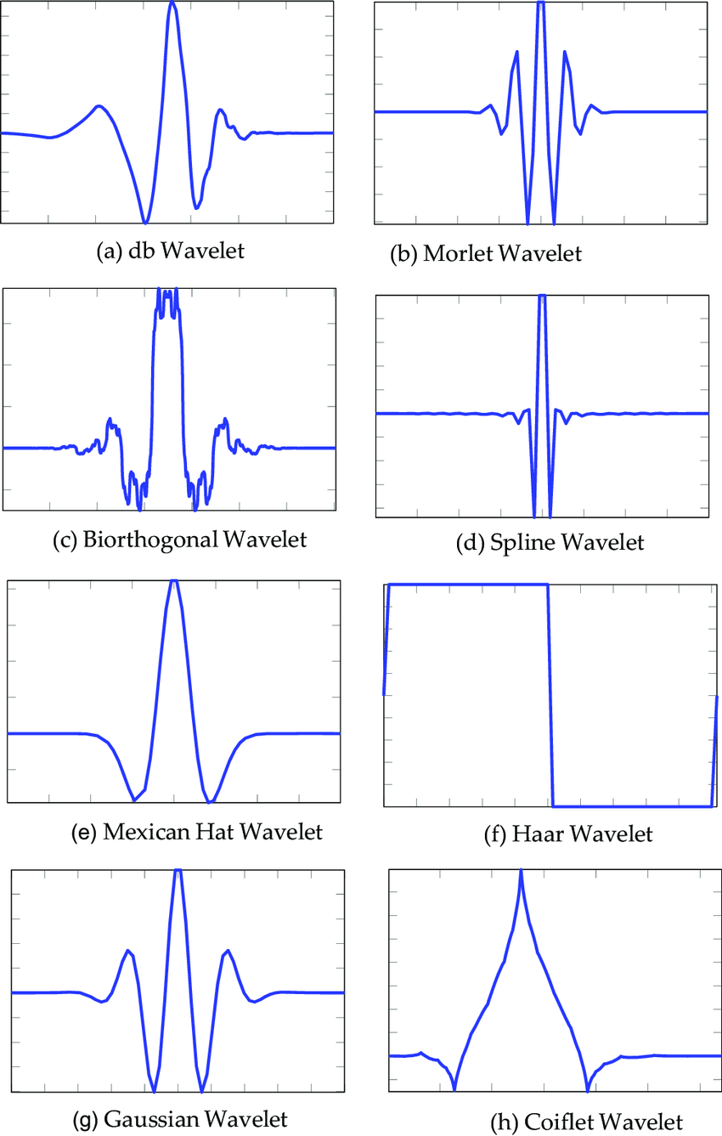
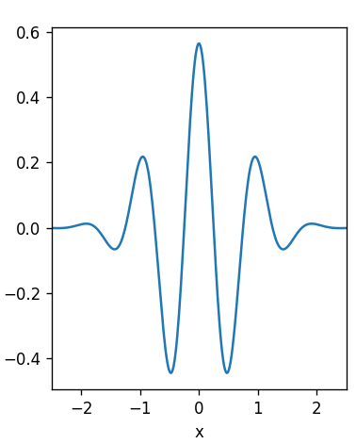

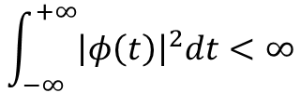
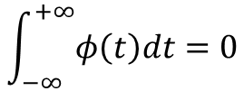

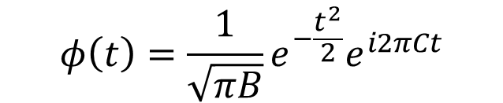
What is Wavelet?
Wavelet is a wave-like oscillation that is localized in time.
Admissibility condition
Zero mean
$$\int_{−∞}^{+∞}{φ\left(t\right)dt}=0$$
Finite energy
$$\int_{−∞}^{+∞}{{\left|φ\left(t\right)\right|}^{2}dt}<∞$$
Localize in time
Morlet wavelet
$$φ\left(t\right)={\frac{1}{\sqrt{πB}}e}^{−\frac{t^{2}}{2}}e^{i2πCt}$$
$$e^{ix}=cosx+isinx$$

Slide 8
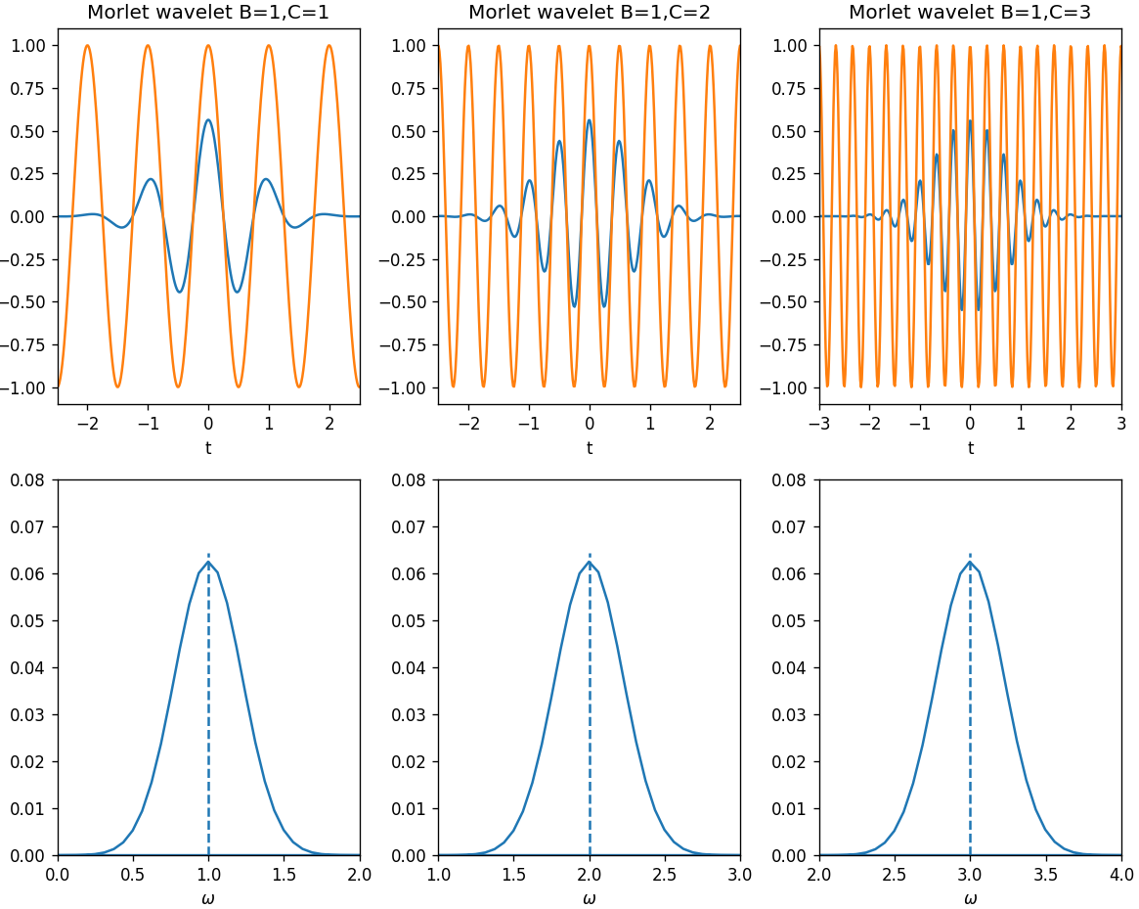
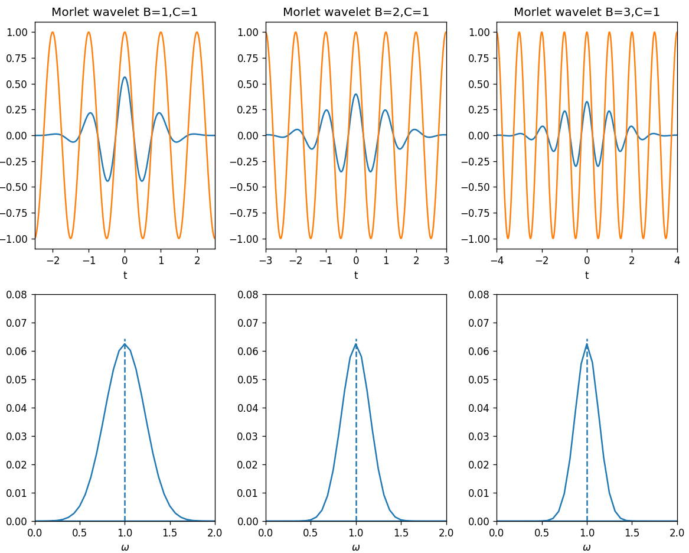

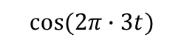
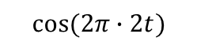
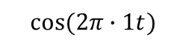
Parameters in Morlet wavelet
$$φ\left(t\right)={\frac{1}{\sqrt{πB}}e}^{−\frac{t^{2}}{2}}e^{i2πCt}$$
Center frequency(C)
Bandwidth(B)
$$cos⁡(2π∙1t)$$
$$cos⁡(2π∙2t)$$
$$cos⁡(2π∙3t)$$
Center frequency

Slide 9
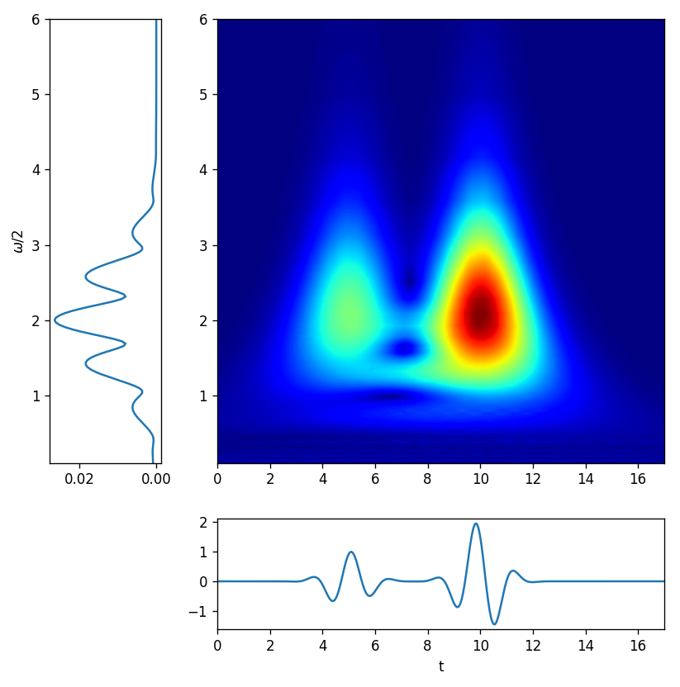

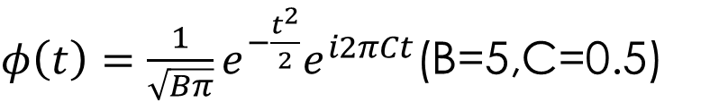

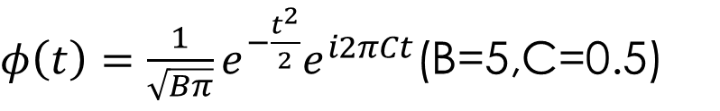
Two examples for wavelet transform
$$χ\left(t\right)=\sin\left(4t\right)e^{−{\left(t−5\right)}^{2}}\sin\left(8t\right)e^{−{\left(t−10\right)}^{2}}$$
$$f\left(t\right)=\sin\left(4t\right)e^{−{\left(t−5\right)}^{2}}+sin⁡(4t)e^{−{\left(t−10\right)}^{2}}$$
$φ\left(t\right)={\frac{1}{\sqrt{Bπ}}e}^{−\frac{t^{2}}{2}}e^{i2πCt}$(B=5,C=0.5)
$φ\left(t\right)={\frac{1}{\sqrt{Bπ}}e}^{−\frac{t^{2}}{2}}e^{i2πCt}$(B=5,C=0.5)
Comp 1
Comp 2

Slide 10
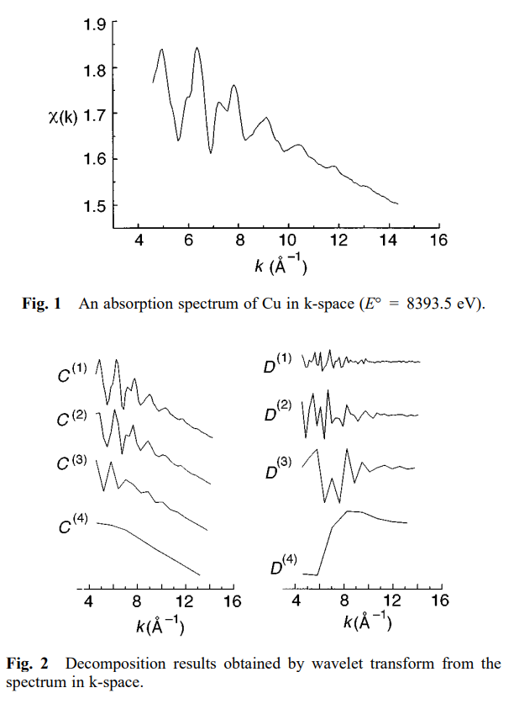
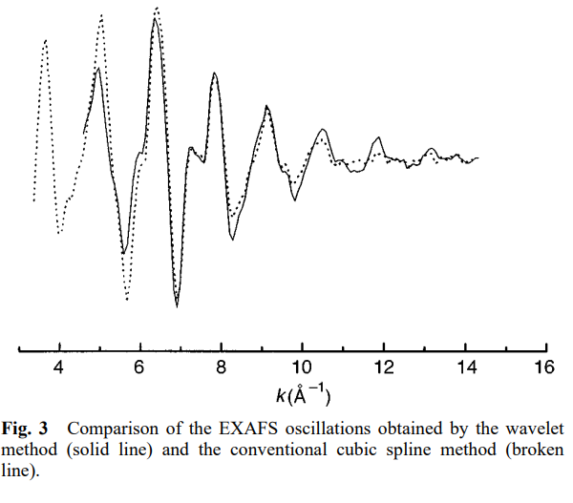
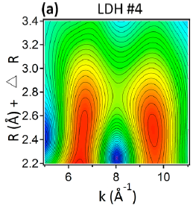

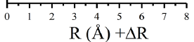
Applications in EXAFS analysis
Cu k-edge EXAFS signal(DWT)
Remove background
Advantage:
To remove the noise in a specific area of both k-space and R-space
Disadvantage:
BG
Hard to de-noise the information which can not be separated well.
Ni:Al ratio = 1.94:1 layered double hydroxides
Xueguang Shao et al. Analytical Communications, April 1998, Vol. 35
Identify local contribution or paths
Al
Ni
J. Phys. Chem. A 2017, 121, 6992−6999

Slide 11
Other applications
Distinguish light atoms(Co-N and Co-C)(J. Am. Chem. Soc. 2017, 139, 9795−9798)
Distinguish unusual interatomic distance(Anal. Chem. 2015, 87, 3520−3526)
Fitting at both k space and R space(Computer Physics Communications 183 (2012) 1237–1245)
Physica B: Condensed Matter 542 (2018) 12–19

Slide 12
Plan
Preform wavelet transform using softwares (Larch…).

Slide 13

Thanks

